Slide 1
Threats with Online Gaming

Slide 2
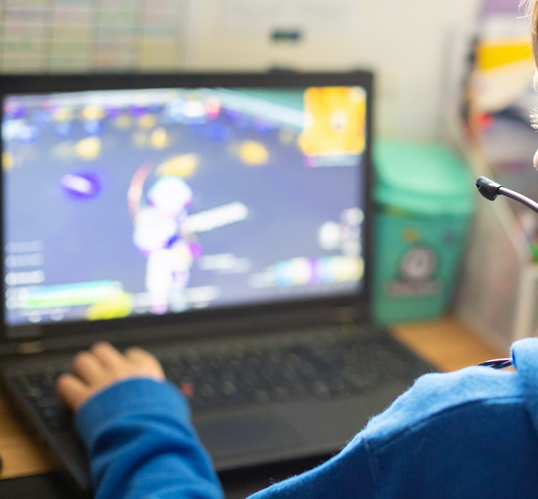
Cyber Threats
Focus Question: What type of attacks can occur when using online games?
Students will:
Identify potential cyber threats.
Create a way to inform others about cyber threats.
Discuss that software has vulnerabilities.
Understand the need for keeping apps and devices up to date.

Slide 3
Cyber Threats
Think and Discuss: How are online games different from other types of games?
Because of those differences, when playing online games, we need to be aware of certain threats and risks.

Slide 4
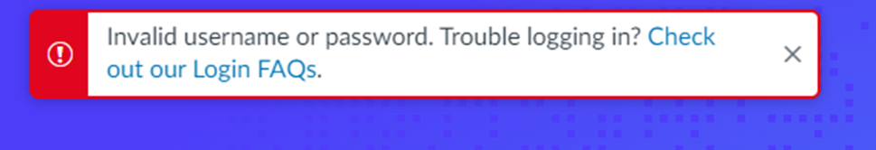
Online Game Scenario
Why does this message appear when you go to login to your favorite online game?

Slide 5
Online Game Scenario
Maybe someone figured out your password and logged into your account and changed your password.
But how can your password be figured out?

Slide 6
Behind the Scenes Attack
A person guessed it right.
Brute Force Attack: A computer program trying all kinds of letter and number combinations until you get it right.
Phishing email/Tricky email

Slide 7
Preventing A Behind the Scenes Attack
Change your passwords every 3-6 months
Use a mixture of:
Uppercase and Lowercase Letters
Numbers
Symbols
Don’t share your password with others!

Slide 8

Online Game Scenario
Why are the graphics on the screen glitching and the Bluetooth keeps disconnecting?

Slide 9
Online Game Scenario
Maybe your device needs to be updated.
Maybe the controller needs to be updated.
Maybe the game or app needs to be updated

Slide 10
Preventing A Behind the Scenes Attack
A device or app that needs an update can start not working correctly.
Backdoor attack: When a person finds a way into the device or app that is not expected.
Updating devices and apps can stop this!

Slide 11
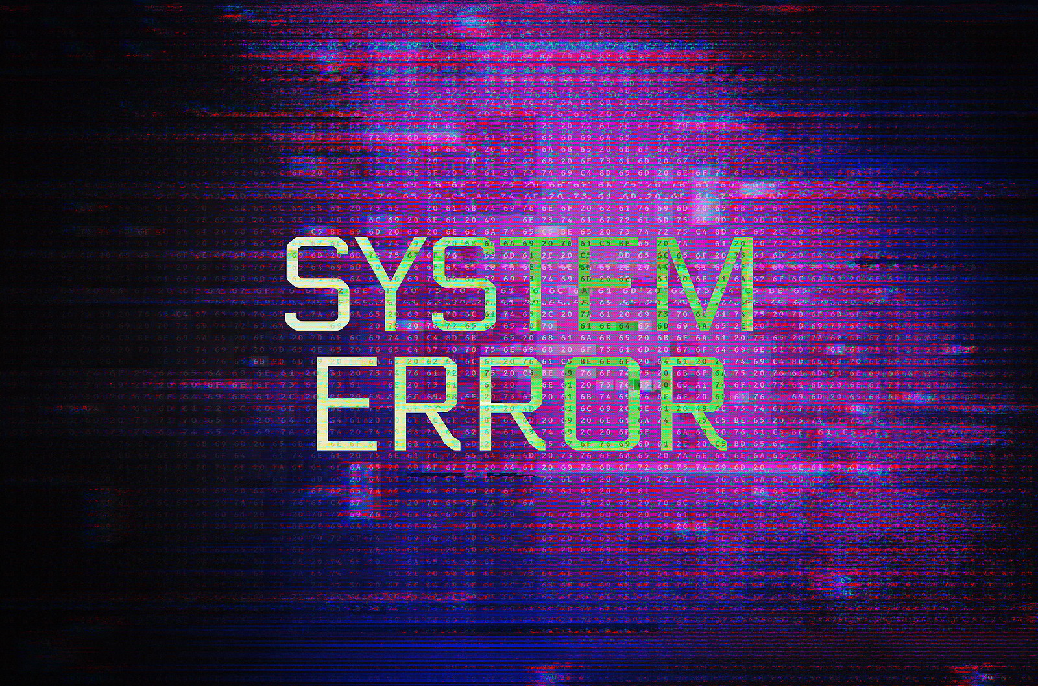
Online Game Scenario
Why is there an error message on the screen saying the game is down?

Slide 12
Behind the Scenes Attack
Maybe someone crashed the game servers by using one of the attacks below:
Too many systems trying to access it at one time.
Distributed Denial of Service Attack (DDoS): Like constantly getting phone calls from unknown numbers so you can’t receive a call from your parents.

Slide 13
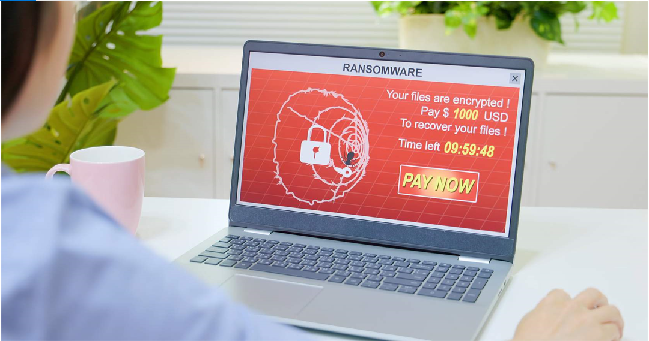
Online Game Scenario
Why do you have an email saying to pay $100 to get your game account back?

Slide 14
Behind the Scenes Attack
Someone will not give you your game until you give them money or points.
This is a ransomware attack
You can prevent this by:
Not clicking on emails
Not sharing your password
Changing your password every few months

Slide 15

Online Gaming Safety Video

Slide 16
Share What You Have Learned
Let your friends and family know how stay safe while having fun using online games!
Think and Discuss:
Pick one of the situations we just discussed.
What do you want to tell other kids?
Is there something you want to teach them?
Is there something you want to make them aware of?

Slide 17
Share What You Have Learned
Let your friends and family know how stay safe while having fun using online games!
Think and Discuss:
What words do you want to put on your poster?
What should you draw on your poster to help other kids understand how to stay safe with online gaming?
You may use one full page or divide the page into 4 different pictures like a comic.

Slide 18
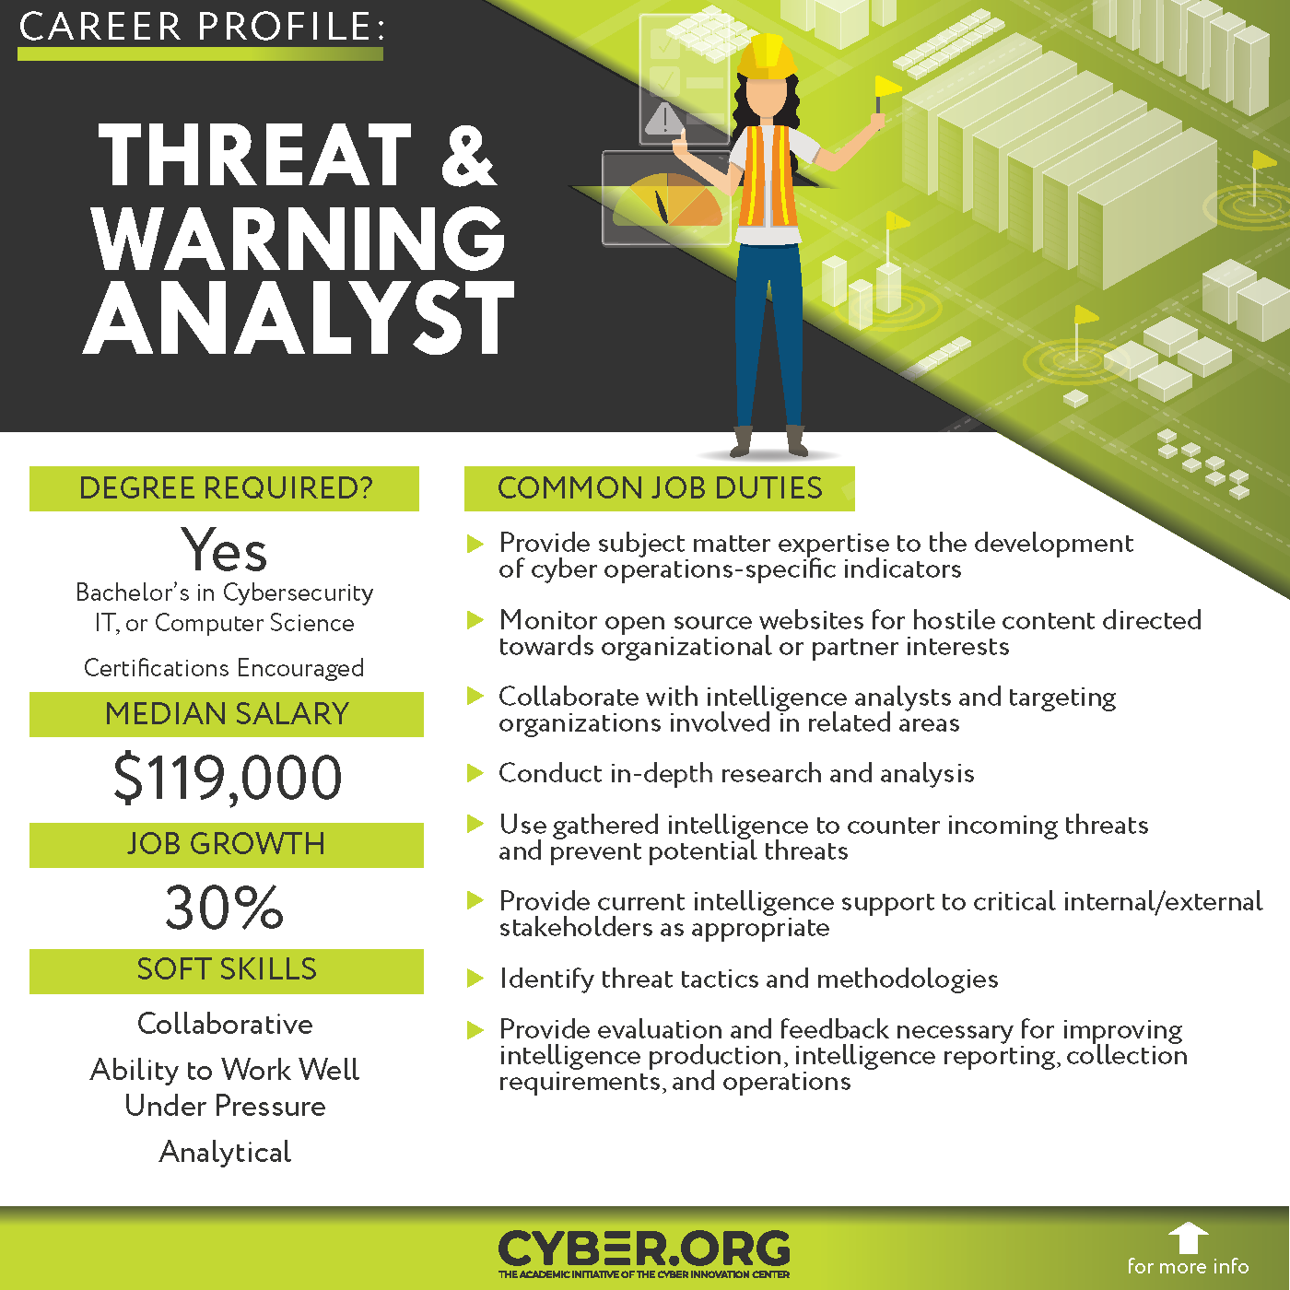
Cyber Career Spotlight: Threat & Warning Analyst

Slide 19
Putting It All Together
We talked about different threats and risks to be aware of when playing online games.
Think and Discuss: What is something that you will do to be safer when using an online game?

